Slide 1
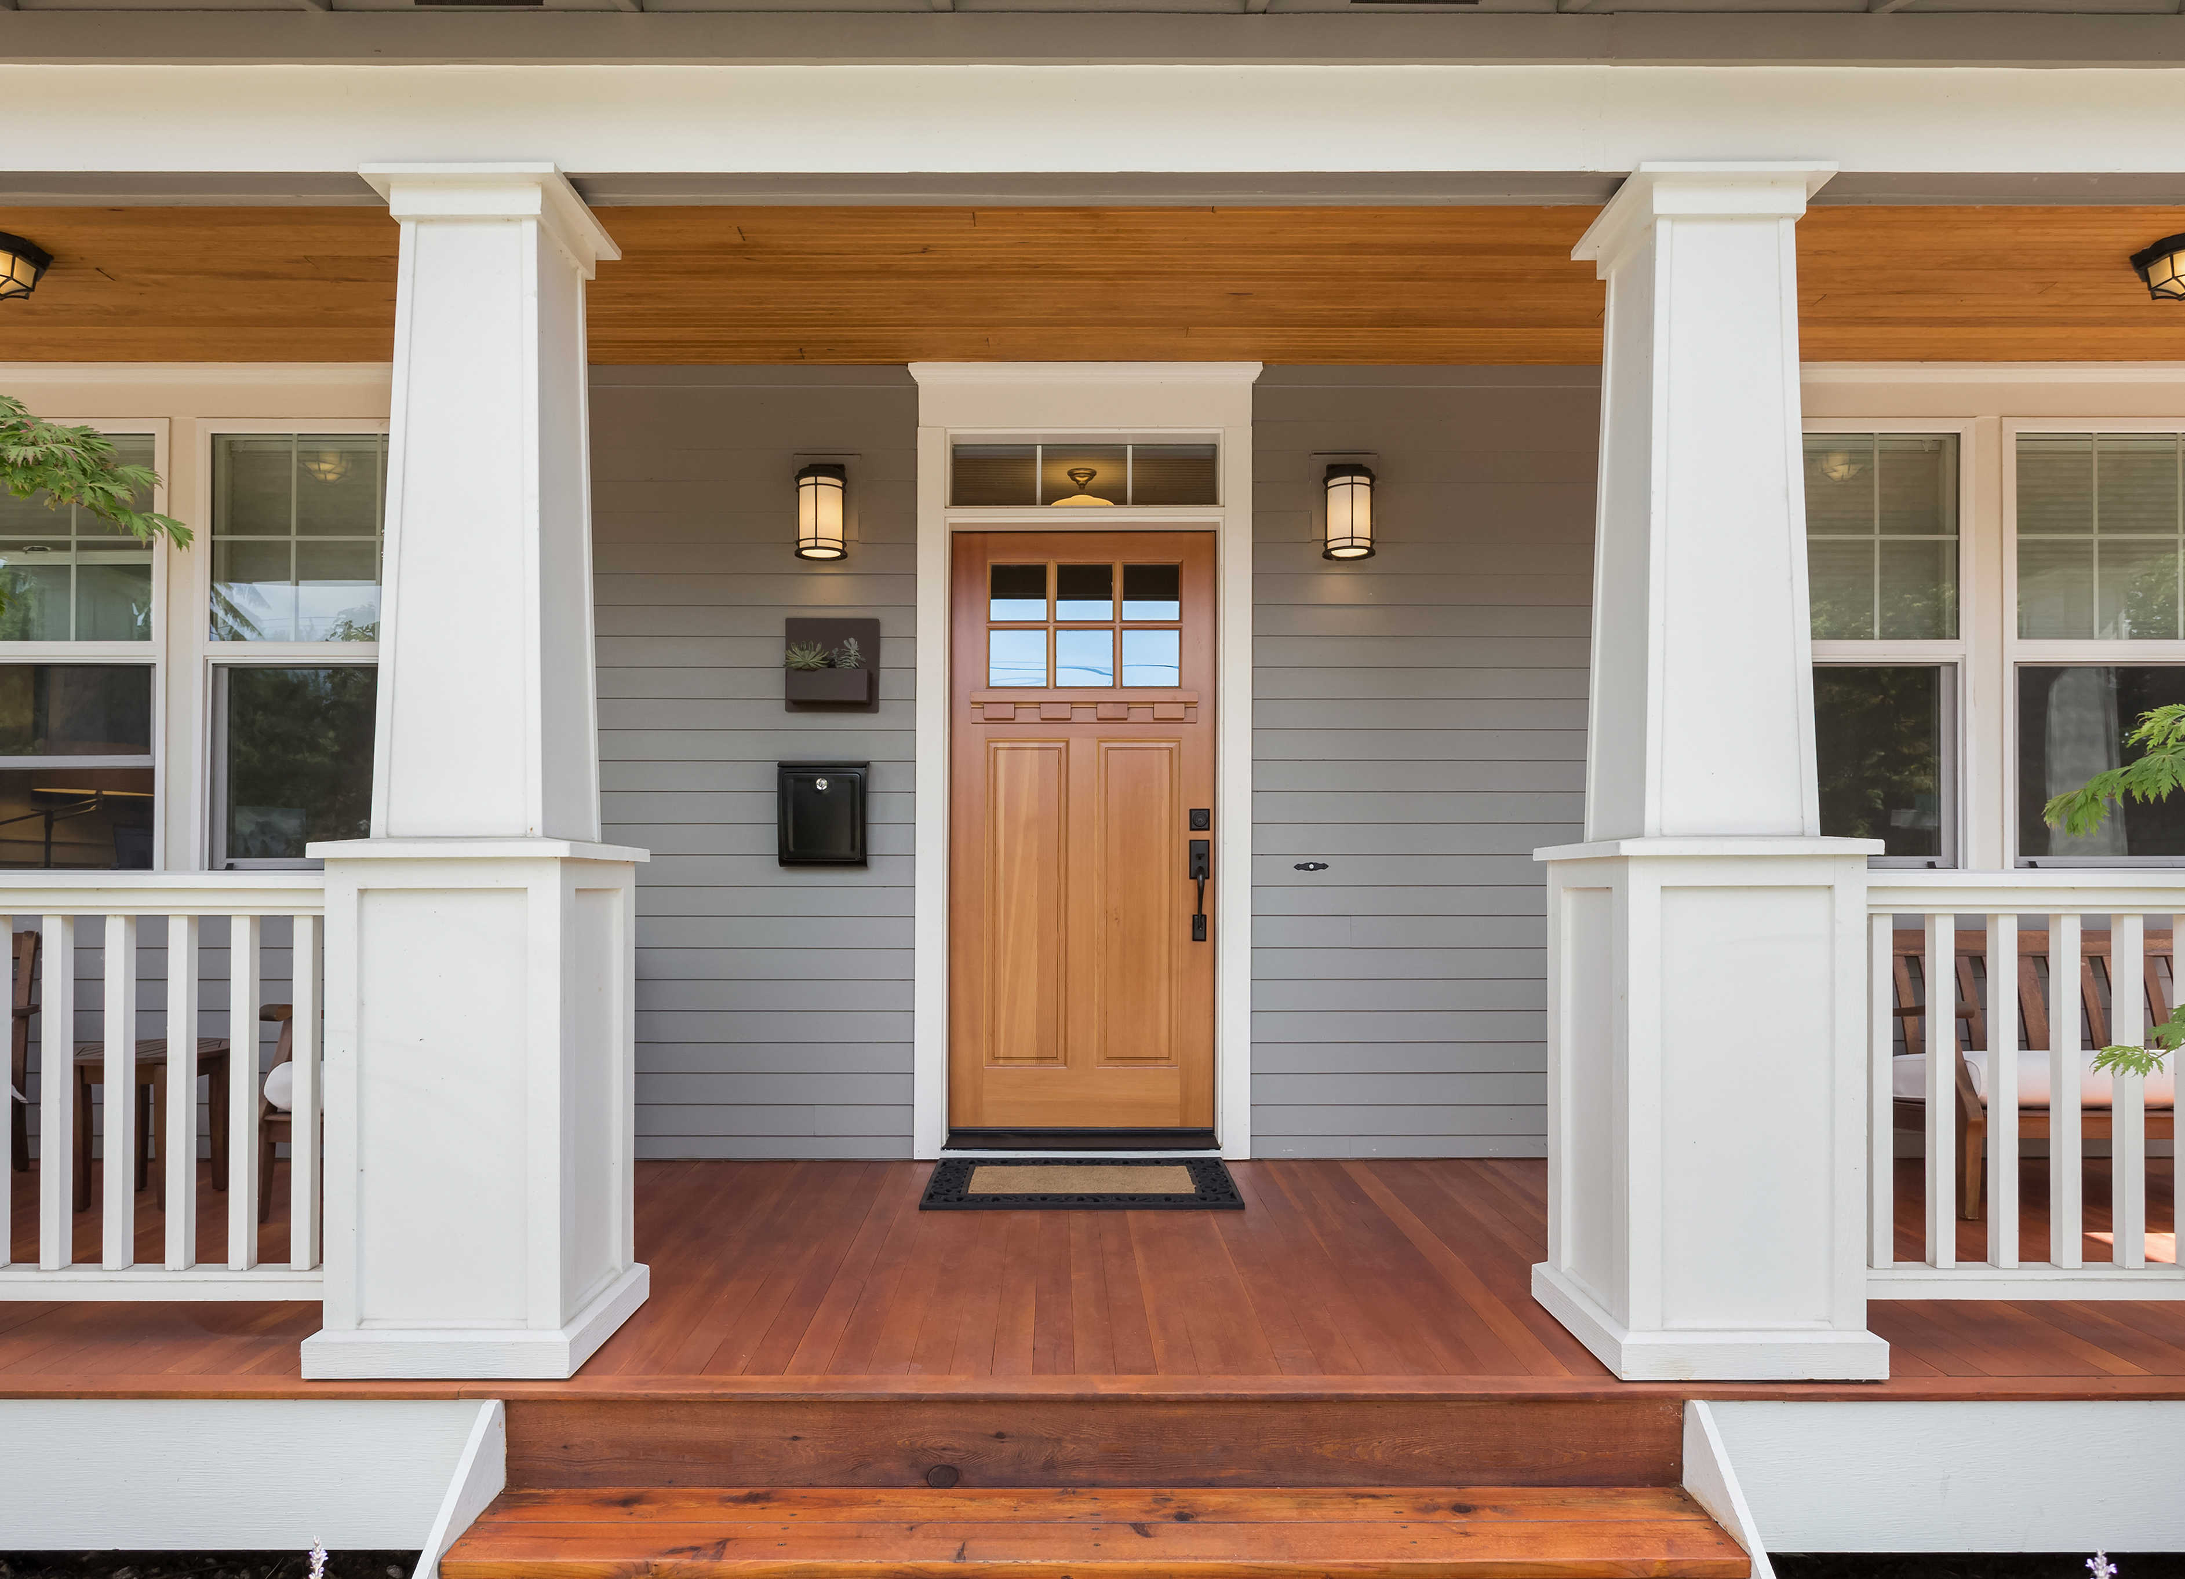
NY MortGaGe TAX STUDY
Team 2 Project #1: Andrea Cereati, Sarah Demmon, Kat McEldowney, Chantal Thomas

Slide 2
AGENDA
I. Mortgage Tax Definitions
II. Current Low Income vs High Income vs Greedy Investor Scenarios
Hypothesis
Method
Data and Insights
Proposal
Revised Low Income vs High Income vs Greedy Investor Scenarios
New Hypothetical Total Estimated Revenue

Slide 3
Mortgage Taxes

Slide 4
Only 7 States have a mortgage tax
Alabama, Florida, Kansas, Minnesota, New York, Oklahoma and Tennessee

Slide 5
What ARE THE home Purchase TAXES IN NY?
When buying a home, New York imposes a mortgage tax and Mansion Tax which is paid upfront at Closing
Mortgage Tax
The tax rate in NY is 1.8% on mortgaged amounts <$500,000 and 1.95% on mortgages >$500,000
*Paid upfront at closing
Mansion Tax $$
There is only a sales tax on homes > $1,000,000 and this amount is only 1%
*Paid upfront at closing
Ubiquitous Sales Tax
?

Slide 6



HOW DO These Taxes WORK?
Investors + Corporations
Lower Incomes
Higher Incomes
John, 50 yrs old, kingpin investor
Matthew, 37 yrs old, earns $200K
Susan, 30 yrs old, earns $55K
Home Purchase Price: $625,000
Down Payment: $625,000 (100%)
Mortgaged Amount: $0
Mortgage Tax: $-
Home Purchase Price: $625,000
Down Payment: $18,750 (3%)
Mortgaged Amount: $606,250 (above $500K)
Mortgage Tax (1.95%): $11,821.87
Home Purchase Price: $625,000
Down Payment: $156,000 (25%)
Mortgaged Amount: $468,000 (under $500K)
Mortgage Tax (1.8%): $8,424

Slide 7
HYpothesis

Slide 8
OUR HYPOTHESIS
We believe that if this tax was lowered and applied across the board to all home purchases, with a higher tax rate applied to investment property purchases, based on property price not mortgage amount, the policy would not only be more equitable, but also raise MORE REVENUE for the government.
We also believe that the mortgage tax is an unfair tax that has a disproportionate impact on people with lower incomes (essentially those that borrow large sums to purchase a home).
2022 Estimated Home Purchase Tax Revenues Raised in Brooklyn
 | Residential | Investors
Mortgage Tax | $ 95,857,551.00 | $ 119,713,118.00 | $ 215,570,669.00
Mansion Tax | $ 76,258,944.00 | $ 78,907,589.00 | $ 155,166,533.00
 |  |  | $ 370,737,202.00

Slide 9
The METHOD

Slide 10
APPROACH
We analyzed the sales data of 15,550 homes sold in Brooklyn, NY in 2022, as well as 2,164 homes sold in 2022 of four of the highest income zip codes and the four lowest income zip codes in the other boroughs. We then segmented the data into two groups – the top and bottom income zip codes
We calculated how much Mortgage tax was raised in Brooklyn. We calculated how much Mansion tax was raised in Brooklyn
We calculated how much would be raised if there was a sales tax that was only 50% of the current Mortgage tax rate and if the Mansion tax was cut in half at 0.5% instead of the current 1%
We used census data to examine the differences in demographics of the different zip codes to see if people with lower incomes are paying a large portion of this tax than people living in zip codes with higher average incomes.
Step 1
Step 2
Step 3
Step 4

Slide 11
The DATA

Slide 12
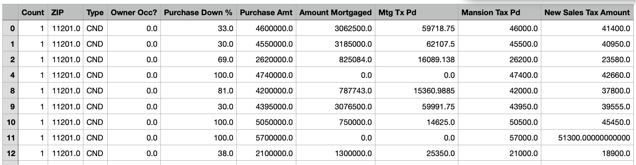
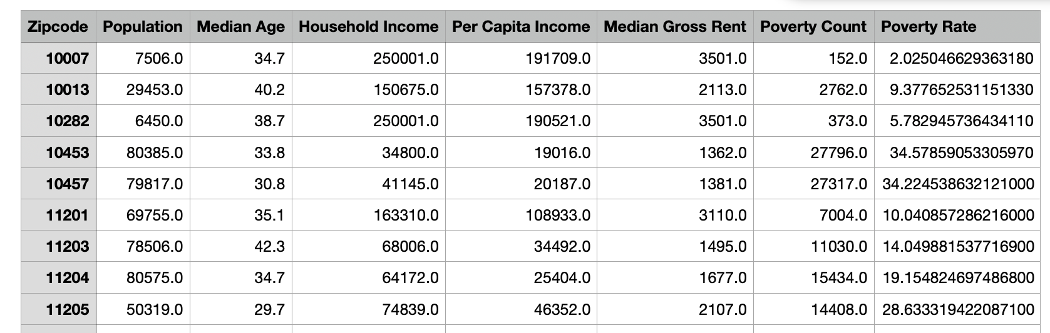
Our Datasets
2022 real estate sales transactional data for Brooklyn NY only
Home Sales broken down by:
Zip, Home Type, Address, Purchase Amount, Purchase Down %, CLTV%, Owner Occupy (y/n), Listed for Sale, Purchase Date, Mortgage Tax Paid, Mansion Tax Paid
Census Bureau API Data
Census data fields:
Zip, Population, Median Age, Household Income, Per Capita Income, Median Gross Rent, Poverty Count, Poverty Rate

Slide 13
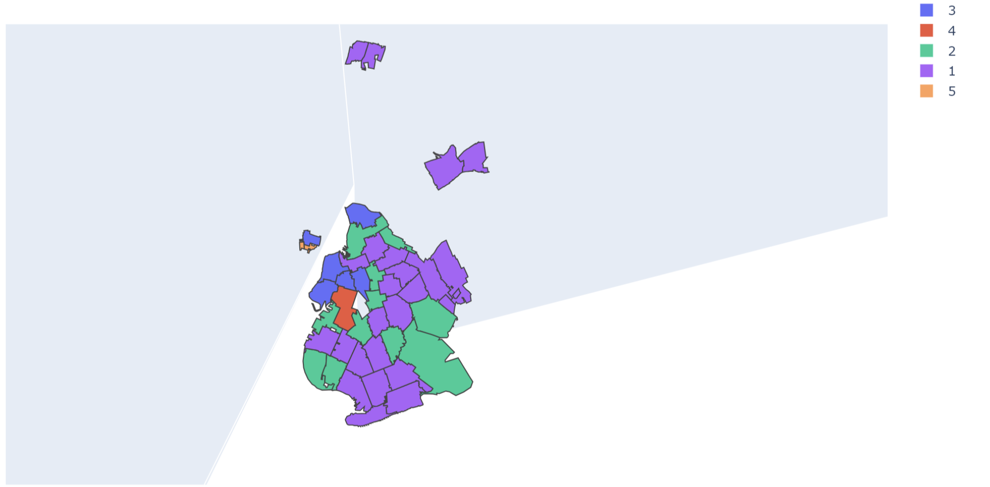
[PLACEHOLDER] Coverage Area Sorted By Income]
Brooklyn NY Area Map w/ Income
Bottom 20% Income
Top 20% Income
Income Ranges
Top 20%:
Bottom 20%:

Slide 14
[PLACEHOLDER] Avg income as percent of mortgage tax?
AVERAGE MEDIAN INCOME GRAPH

Slide 15
[PLACEHOLDER] Zip code map showing percent of sales tax paid

Slide 16
[PLACEHOLDER] Brooklyn showing the amount borrowed by income level
Total , owner occ, investor

Slide 17
[PLACEHOLDER] Other Zips showing the amount borrowed by income level
Total , owner occ, investor

Slide 18
[PLACEHOLDER] Income level vs zip code

Slide 19
Proposal

Slide 20
PROPOSED NEW TAX SOLUTION
To make taxes on home sales more equitable…
We propose the mortgage tax get slashed by 50% and we instate a NEW Sales tax on ALL home sales in lieu of a Mortgage tax.
We would do away with the Mansion tax.
For the corporation/ investor population, we would create an Investment tax of 4.4357%.
OLD
NEW
Mortgage Tax = 1.8%<$500,000, 1.95% > 500,000
Home Sales Tax = .9% <$500,000, 1.4% >$1,000,000
Mansion Tax = 1.0%
Sales Tax on Investments = 4.4357%

Slide 21
HOW DOES THE NEW TAX AFFECT buyers?
Investors/Corporations
Lower Incomes
Higher Incomes
John, 50 yrs old, kingpin investor
Matthew, 37 yrs old, earns $200K
Susan, 30 yrs old, earns $55K
Home Purchase Price: $625,000
Down Payment: $625,000 (100%)
Mortgaged Amount: $0
Investment Sales Tax (4.4357%): $27,723
Home Purchase Price: $625,000
Down Payment: $18,750 (3%)
Mortgaged Amount: $606,250
Sales Tax (.9%): $5,625
Home Purchase Price: $625,000
Down Payment: $156,000 (25%)
Mortgaged Amount: $ 468,000
Sales Tax (.9%): $5,625

Slide 22
[PLACEHOLDER] New Sales Tax vs Income level

Slide 23
DOES THE SALES TAX GENERATE MORE REVENUE FOR NY?
Yes, assuming that home purchase behaviors will remain the same. Based on our sample 2022 data,
we have confidence that these revenues are realistic.
PRE
POST
 | Residential | Investors | Total
Mortgage Tax | $ 95,857,551.00 | $ 119,713,118.00 | $ 215,570,669.00
Mansion Tax | $ 76,258,944.00 | $ 78,907,589.00 | $ 155,166,533.00
 |  |  | $ 370,737,202.00
 | Residential | Investors | Total
Sales Tax | $ 114,342,909.00 | $543,095,776 | $ 657,438,685.00

Slide 24
[PLACEHOLDER] Pie Chart - Total Amount Tax Collected 2022 vs New Sales Tax

Slide 26
QUESTIONS?

